Slide 1

Trends in Innovation and IP and the role of LESI
Fiona Nicolson
LESI President
Partner, Bristows LLP
Advancing the Business of Intellectual Property Globally

Slide 2
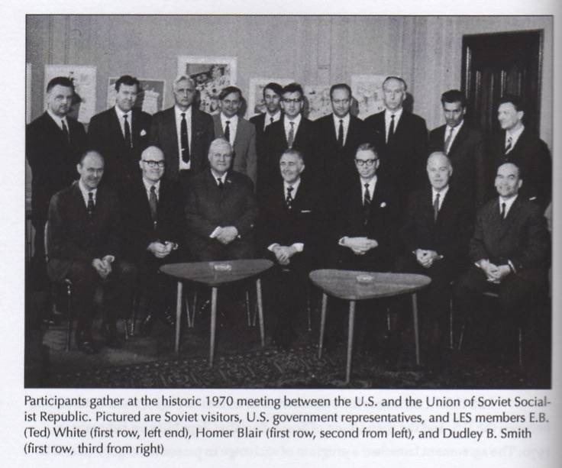
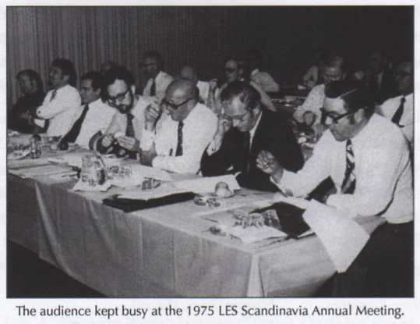
The IP World has changed over the last 45/50 years and so has LES!
Photos from LES Meetings in the 1970’s
Advancing the Business of Intellectual Property Globally

Slide 3

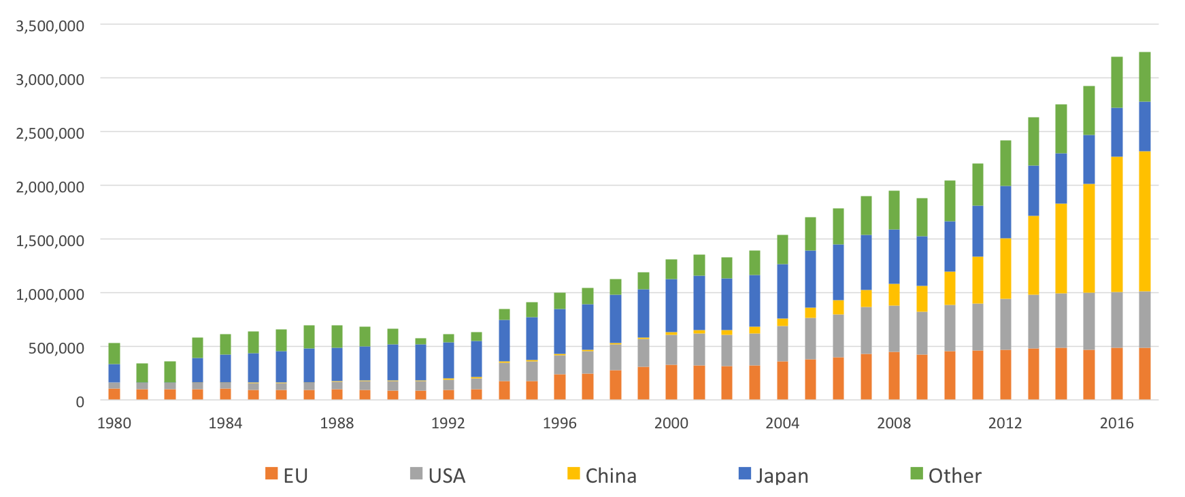
Global Patent Application Filings Since 1980
Advancing the Business of Intellectual Property Globally

Slide 4
Big Players are Investing in Artificial Intelligence
source: https://www.wipo.int/edocs/pubdocs/en/wipo_pub_1055.pdf
Advancing the Business of Intellectual Property Globally

Slide 5

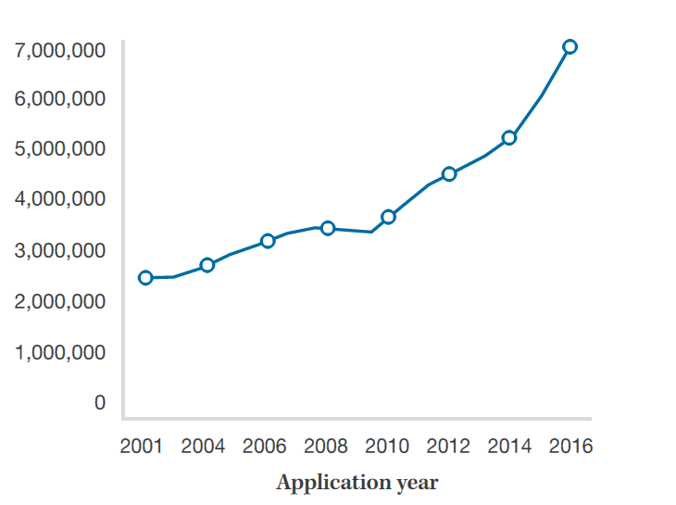
Global Trademark Applications
2001 - 2016
https://www.wipo.int/edocs/pubdocs/en/wipo_pub_941_2017-chapter3.pdf source - WIPO Statistics Database September 2017
Advancing the Business of Intellectual Property Globally

Slide 6
Creating an International Patent System
Europe Creates the European Patent Office 1977
Trend of global integration of institutions and harmonization of standards
Unification of European patent system is part of this wider global trend.
Centralized searching, examining, and granting of patent rights
National enforcement of patent rights remains
Advancing the Business of Intellectual Property Globally

Slide 7
China - National Promotion of Patent Filings
China Supports the Filing of Patent Applications by Chinese Organizations
Chinese Patent Filings Surpass US Patent Filings in 2012
1978: start of modern IP system in China, as a product of China’s reform and opening up policy
1980-1990: Joining WIPO, System establishment
2001-2008: Joining WTO, TRIPS
2008-2015: Cohesion and Coordination
After 2016: IP related laws and regulations are revised
  Implementing the national strategy with strong IP competence
  Setting up of Intellectual Property Courts
https://slideplayer.com/slide/12301629/
Advancing the Business of Intellectual Property Globally

Slide 8
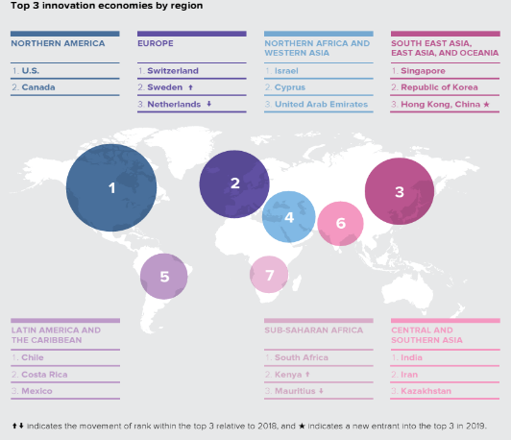
Future Trends in Innovation
1) IP Global Trends in Innovation
Advancing the Business of Intellectual Property Globally
Source: WIPO Report Global Innovation Index 2019: Creating Healthy Lives – The Future of Medical Innovation.

Slide 9
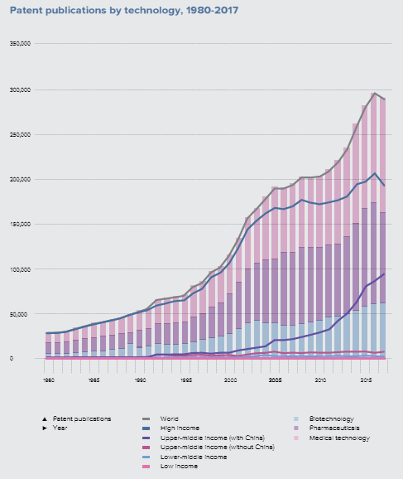
2) Innovation in Medical Technology
WIPO predict IT-led innovation will drive the next wave of healthcare evolution.
Global medical technology patent publications increased by 6% per year over the last decade.
Source: WIPO Report Global Innovation Index 2019: Creating Healthy Lives – The Future of Medical Innovation.
Advancing the Business of Intellectual Property Globally

Slide 10
3) Emerging Technology and Disruptive Business Models
Rising roles of internet platforms and social media
Rising Importance of Artificial Intelligence
Digital Economy Challenges for Existing Legislation and Regulatory Frameworks
Advancing the Business of Intellectual Property Globally

Slide 11

4) Increasing Number of Female Inventors Over the last 40 Years
Source: https://www.uspto.gov/sites/default/files/documents/Progress-and-Potential.pdf
Advancing the Business of Intellectual Property Globally

Slide 12


Who Owns the Right to New Technology Innovations?
Advancing the Business of Intellectual Property Globally

Slide 13
1) Future of SEPs
Future technologies such as IoT, smart cars, smart home and smart energy will increasingly rely on patented technology standards such as LTE, Wifi, NFC, RFID and Bluetooth.
The number of declared SEPs is constantly increasing.
The number and diversity of rights holders is also increasing.
The variety of business models is increasing
Buying SEPs may be a way to enter new markets, negotiate licensing deals, and avoid costly litigation.
Companies should pursue a common strategy for patenting and standardization to ensure that they are aware of the existence of SEPs and are exploiting patented inventions in technology fields where standards matter.
Advancing the Business of Intellectual Property Globally

Slide 14
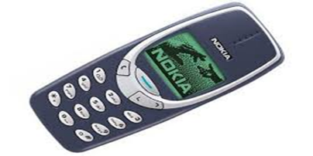

2) Who Should be Licensed?
System, End Product, Component, IC?
Advancing the Business of Intellectual Property Globally

Slide 15

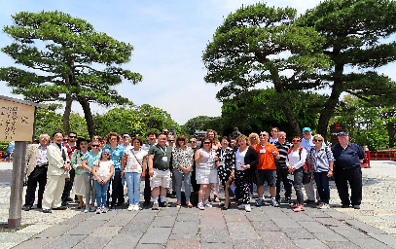
The Role of LESI as a Platform for
LES Andean Community
LES Arab Countries
LES Argentina
LES Australia & New Zealand
LES Austria
LES Benelux
LES Brazil
LES Britain & Ireland
LES Chile
LES China
LES Chinese Taipei
LES Czech Republic & Slovakia
LES France
LES Germany
LES Hungary
LES India
LES Israel
LES Italy
LES Japan
LES Korea
LES Malaysia
LES Mexico
LES Philippines
LES Poland
LES Russia
LES Scandinavia
LES Singapore
LES South Africa
LES Spain & Portugal
LES Switzerland
LES Turkey
LES Thailand
LES USA & Canada
Professional Education
Professional Engagement, Networks and Collaboration
Identifying and Addressing Key Issues
Growing an International Community of IP business people and IP professionals
Advancing the Business of Intellectual Property Globally

Slide 16



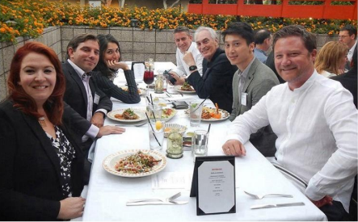
Value Proposition
International Networking
IP and Licensing Education
Exclusive Membership Directory
Publications
YMC (Young Members Committee)
WILA (Women in Licensing Alliance)
Licensing Royalty Rate Survey
Advancing the Business of Intellectual Property Globally

Slide 17
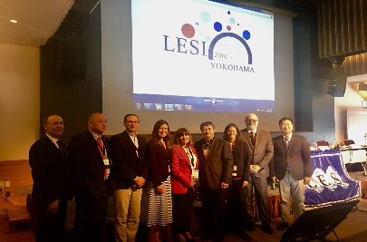
Committees
30 LESI Committees including industry committees open to all members – some examples
High Technology
Life Sciences
Environment, energy materials and chemicals
IUGT (Industry University and Government Transactions)
Business Primer (ad hoc Committee)
Consumer Electronics
Advancing the Business of Intellectual Property Globally

Slide 18
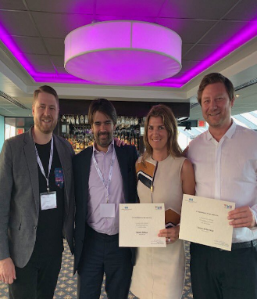
LESI - Professional Engagement and Collaboration
Identifying and Addressing Key Issues
Board develops strategy and liaises with committees
Committees collect input and implement programs
Industry Advisory Boards provide input on programs, speeches, and issues
National coordinators provide international input
External relations and projects with CNIPA, EPO, AIPLA
IP Standards
Advancing the Business of Intellectual Property Globally

Slide 19

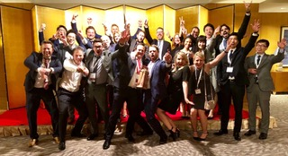
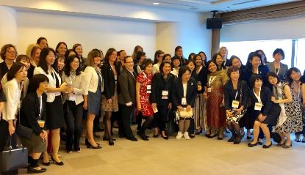
YMC
WILA
Young Members Congress (YMC)
Hosts Regional Meetings
Women in Licensing Alliance (WILA)
Inaugural Event held
Yokohama May 2019
Advancing the Business of Intellectual Property Globally

Slide 20
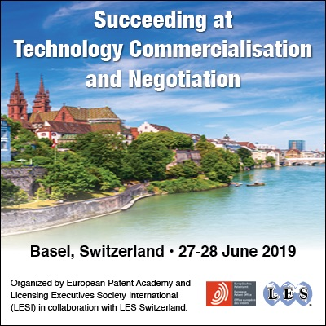
Licensing Education
LESI is proud of its partnerships with organizations, such as the EPO.
LESI/EPO two-day course given in Basel and Istanbul this year.
We also partner with CNIPA and LES China on a Beijing training course
Advancing the Business of Intellectual Property Globally

Slide 21

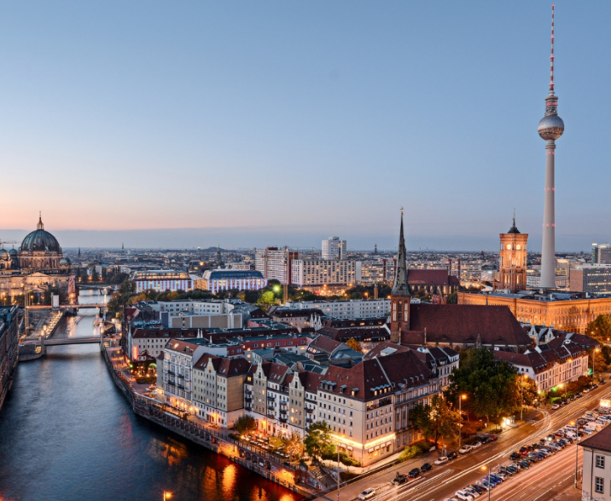
Meetings
LES INTERNATIONAL ANNUAL CONFERENCE 2020
16-20 May 2020
Berlin, Germany
STATION, Berlin
Luckenwalker Str. 4-6
10963 Berlin, Germany
Advancing the Business of Intellectual Property Globally

Slide 22
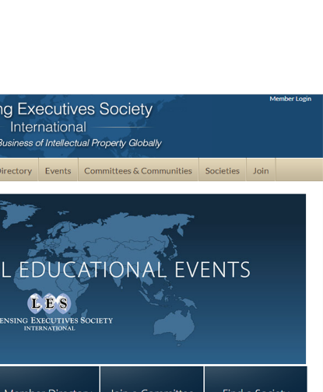
LES Plays a Central Role in the Business of Innovation and Intellectual Property Serving as a Platform for
Engaging the players
Identifying and addressing key issues
Building collaboration and community
Are you a member?
Advancing the Business of Intellectual Property Globally

