Slide 1
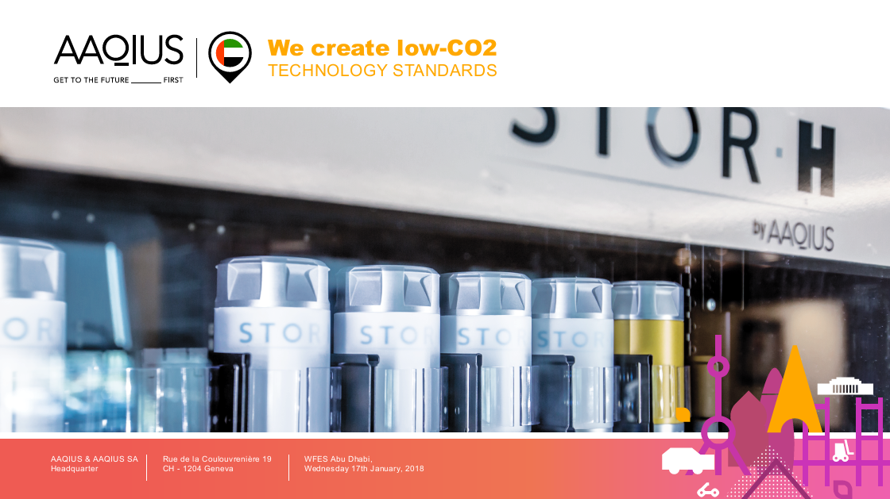


IP and energy transition:
the « green » hydrogen economy
AAQIUS
Pôle Avancé de Recherche
& d’Innovation
12 rue Vivienne
75002 Paris
France

Slide 2
Key issues
    Is sustainable development possible?
    Can market forces decarbonate the global economy?
    What levels of investments are needed?
    What is the impact/role of IP?
    Which deployment strategies are most effective, traditional vs disruptive?

Slide 3
Development as measured by GDP requires…innovation and…
Steam Engine Patent (James Watt)
1769
Sources: Nicolas Meilhan « The end of growth? », Angus Maddison

Slide 4
…energy…but carbon-intensive energy sources are finite…and not compatible with sustainable development…
World GDP
R/P (BP2015)
50 years
114 years
« When the Industrial Revolution started, the amount of carbon sitting in coal under Britain was roughly the same as the amount sitting in oil under Saudi Arabia » David Mackay
53 years
Renewables
Sources: Nicolas Meilhan « The end of growth? », Schilling et al, BP Statistical Review 2013

Slide 5
…current efforts are not enough to limit climate change to below 2°C…

Slide 6
… « fueling » sustainable development will require increasing efficiency and decarbonizing energy…

Slide 7
…with market forces driving down renewable costs…

Slide 8
… thus giving « green » hydrogen key roles in decarbonizing major sectors of the economy…

Slide 9
… in markets where the stakes are enormous (475 Bn USD).

Slide 10
Green energy patent filings have peaked…

Slide 11
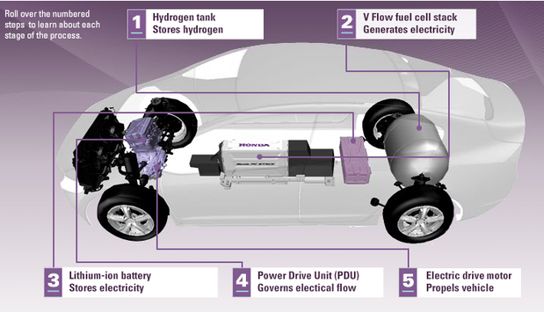
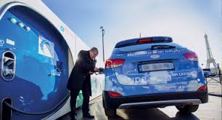
… key components in hydrogen mobility are the Filling Station, H₂ Storage, the Fuel Cell…
Honda FCX Clarity Fuel Cell Electric Vehicle

Slide 12
…reflecting progression from R&D to commercial implementation...
“As we have noted, more modest growth in patent numbers is a positive indicator if it reflects a progression from research and development, and the intensive fund-raising phase, to commercial implementation within a maturing industry.”

Slide 13

… which will lead to an acceleration of patent disputes…
    Example, semiconductor industry: 1970s - 1980s, the pace of issuance of semiconductor patents and the amount of semiconductor patent litigation activity were both fairly constant and relatively low.
    1990s: semiconductor patenting became much more intense, showing more growth than other industries over the same period, and creating patent “thickets” that became difficult for semiconductor firms to navigate.
    A wave of semiconductor patent litigation hit the U.S. court system.
    Eastern District of Texas became a popular venue largely as a result of Texas Instruments’ assertive litigation strategy. TI brought numerous lawsuits in the Eastern District. The speedy court dockets in Texas forced settlements on TI’s terms.
Source: Teague I. Donahey (partner in Sidley Austin LLP)

Slide 14
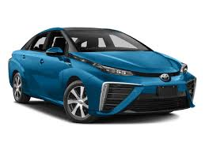
…with key players already positioning themselves: Toyota’s royalty-free patent initiative…
    Toyota will allow royalty-free use of 5,680 of its Fuel Cell Vehicle patent licenses by those manufacturing and selling FCVs through the initial market introduction period, which is anticipated to continue until about 2020.
    This initiative will include patents that are critical to the development and production of FCVs,
      such as those relating to fuel cell stacks (approx. 1,970 patent licenses),
      high-pressure hydrogen tanks (approx. 290 patent licenses),
      and fuel cell system control technology (approx. 3,350 patent licenses).
    To facilitate more rapid expansion of hydrogen station networks, Toyota will also provide royalty-free use of approximately 70 hydrogen-station-related patent licenses indefinitely for those installing and operating hydrogen stations.
    Toyota plans to make the royalty-free patent licenses available for use to companies and organizations that conclude contracts with Toyota based on negotiations with the company concerning specific usage plans, in line with standard patent license usage procedures.
Source: Toyota press release January 2015

Slide 15
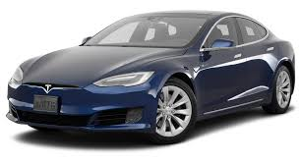
…in response to Tesla’s patent pledge…
    “All Our Patent Are Belong To You” (sic), Elon Musk, CEO
    June 12, 2014 (blog)
    “Yesterday, there was a wall of Tesla patents in the lobby of our Palo Alto headquarters. That is no longer the case. They have been removed, in the spirit of the open source movement, for the advancement of electric vehicle technology.”
    “Tesla Motors was created to accelerate the advent of sustainable transport. If we clear a path to the creation of compelling electric vehicles, but then lay intellectual property landmines behind us to inhibit others, we are acting in a manner contrary to that goal. Tesla will not initiate patent lawsuits against anyone who, in good faith, wants to use our technology.”
    Source: https://www.tesla.com/blog/all-our-patent-are-belong-you?redirect=no

Slide 16
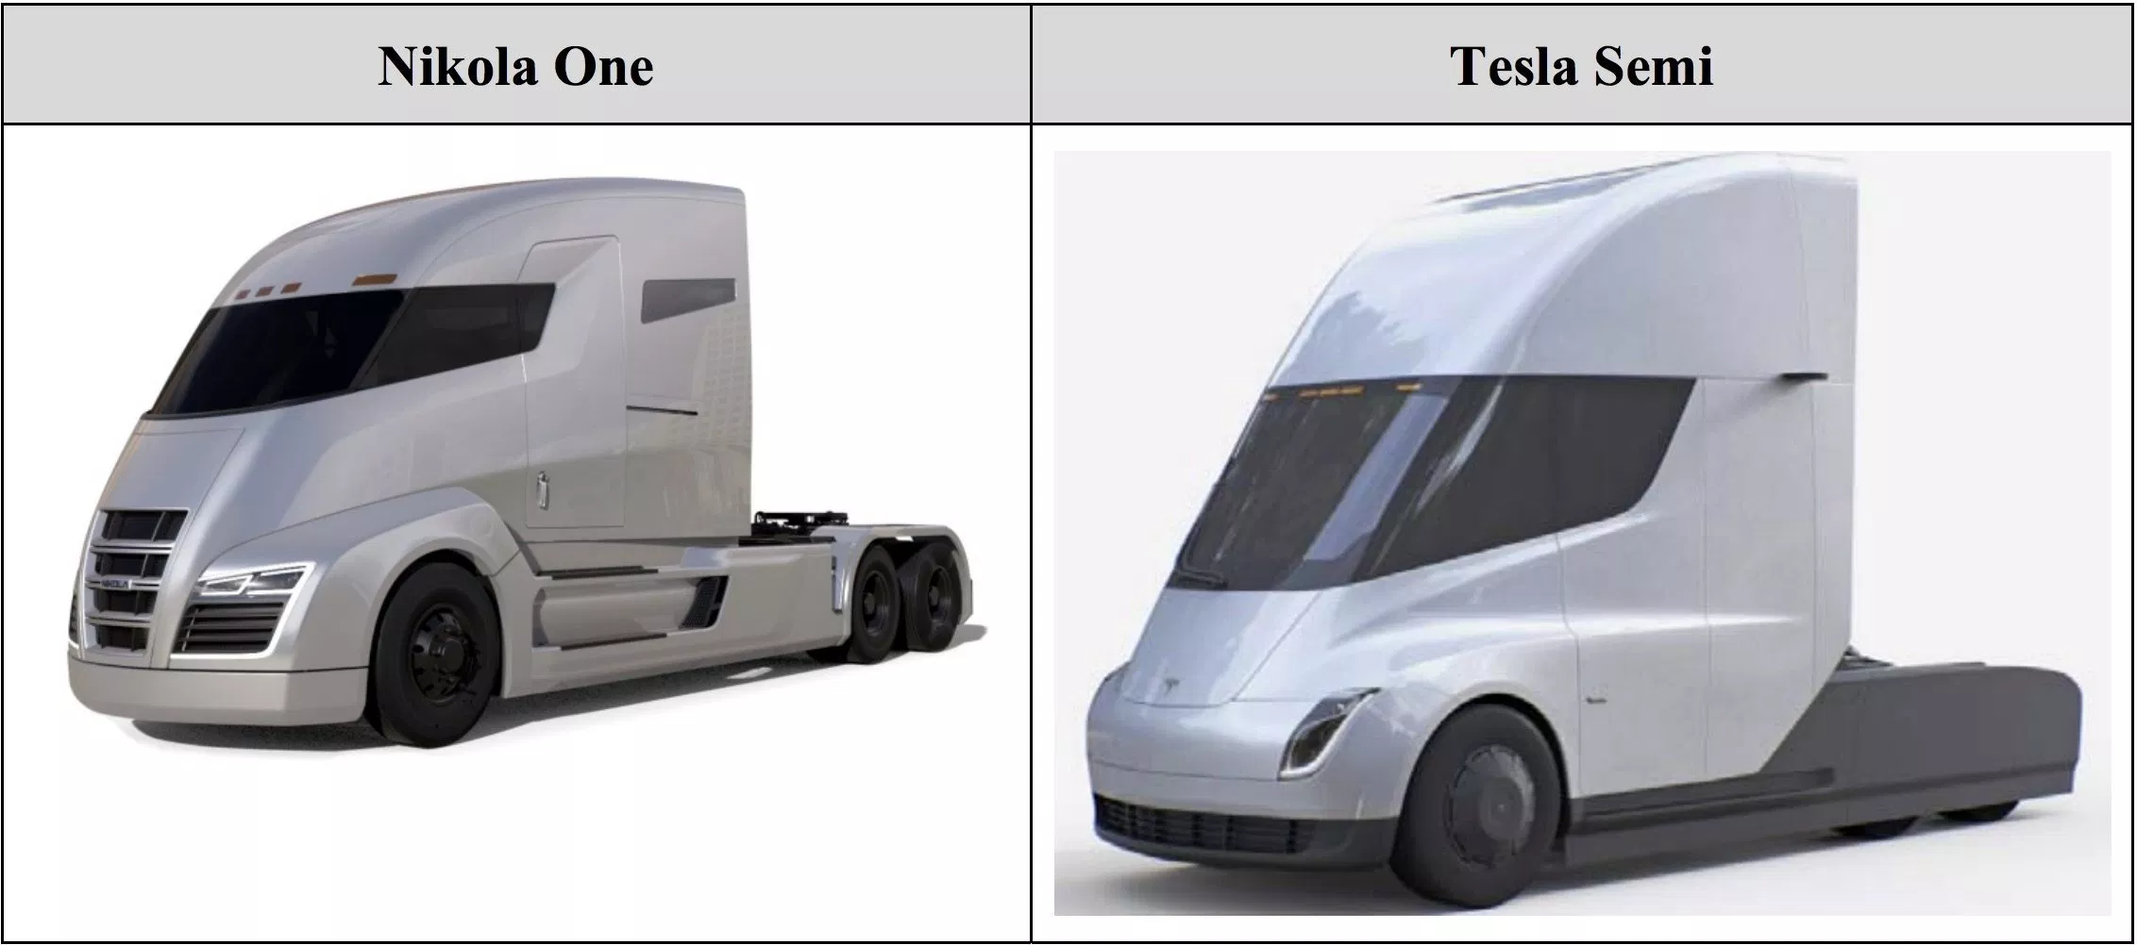
…with hydrogen truck start-up / unicorn Nikola adopting a more aggressive strategy…
    Tesla is currently being sued by Nikola Motors for $2 billion over the design of the Tesla Semi; Tesla has requested to transfer the case to the Northern District of California, where Tesla is based, from Arizona, where Nikola is based.
    Nikola Motors has just raised $105 million in a Series C round of funding, with plans to raise another $100 million to $150 million as the startup plans to build the largest hydrogen network in the world. The oversubscribed C round gives the startup a $1.1 billion pre-money valuation, considered a unicorn in the startup world.
    Nikola has close to $11 billion in pre-order reservations, including an 800-truck order from beer giant Anheuser-Busch. Plans are to have more than 700 hydrogen stations across the U.S. and Canada by 2028, with full production planned by 2021.

Slide 17
…and the arrival of non-traditional players pushing towards disruptive deployment strategies…

Slide 18




…for example, an innovative technology is not enough to effectively compete…
« Traditional »
« Disruptive »

Slide 19


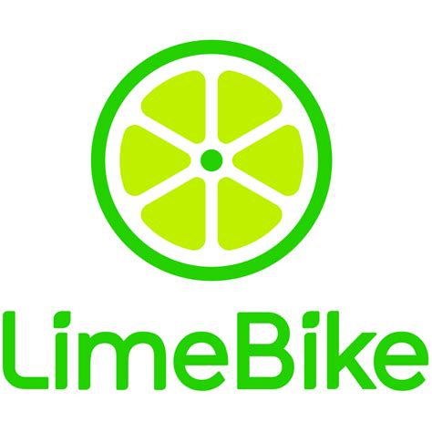




…in the highly dynamic urban mobility market segment…
July 2018:
$4 686 million cumulative capital raised since 2016
Over 250 million users for companies shown below
… ?
*
* Investments in JUMP and LIME

Slide 20
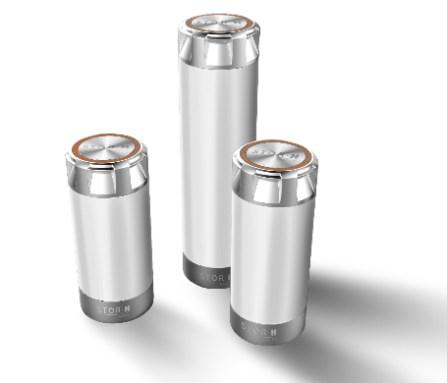
…STOR.H: the zero-carbon energy standard for urban mobility…a disruptive deployment strategy…
STOR.H
Make STOR.H the new global zero-carbon energy standard
Develop and deploy an innovative energy consumption approach, which is both digital and user-friendly, for urban mobility
The new energy standard
for green mobility
Achieve leadership in green lightweight (<1 tonne) urban vehicles for city centers and enclosed areas (airports, ports, …)
Set up a green hydrogen value chain to speed up the adoption of a sustainable business model
Achieve and maintain top-of-mind mobile app awareness

Slide 21

…offers a simple, safe, and green user experience…
Readily available
Plug & drive
The distribution infrastructure (vending machines) is simple and inexpensive. The cartridges can be made available anywhere, anytime.
As soon as you " click " the cartridges in place, the hydrogen will be converted to electricity.
.
STOR H
Zero CO2 emissions
No CO2 emitted during your trip… and the best way to store renewable energy.
The new energy standard
for green mobility
Excellent Range
A scooter equipped with the STOR-H system can easily achieve a 100 km range with only a few cartridges.
Small environmental footprint
The cartridge has a minimal environmental impact and can be refilled thousands of times and at end-of-life all of its materials can be recycled.
Completely safe
An easy to use can
The STOR-H standard is a way to store hydrogen at very low pressures without any risk of explosion.
Through the use of cartridges, hydrogen becomes simple to transport and to use.

Slide 22
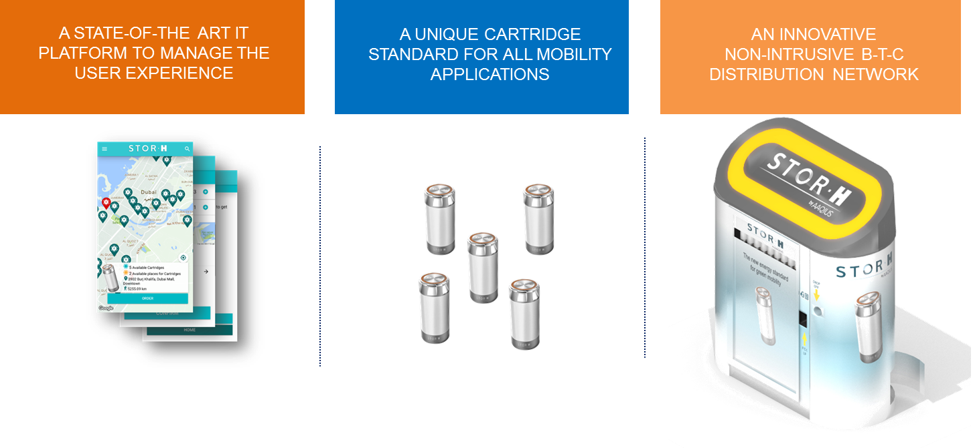
…and a solution focused on new mobility usage habits…

Slide 23














…creating a new worldwide standard for energy consumption based on non-intrusive infrastructure…
CORE ENVIRONMENT
CORE BUSINESS
Hydrogen production
Full cartridgess
ready for use
Vehicles using hydrogen cartridges
Filling station
Milk-run logistics for refilling cartridges
Customer
Vending
Machine
STOR.H
APP
Long lasting cartridges can be refilled more than 5000 times and are fully recyclable
Empty cartridges to be refilled
Canister production

Slide 24


…enabling a complete hydrogen urban mobility ecosystem with 2 global storage standards

Slide 25
Key takeaways
    Sustainable development is impossible without zero-carbon energy
    Falling renewable energy costs enable green H₂ to massively decarbonate the economy
    The opportunities for green H₂ are enormous: 475 Bn USD investments by 2030
    Patenting activity in green energy confirms transition from R&D to deployment phase
    Traditional strategies focused on technology/function (Total, Shell, Toyota, EDF, …) drive less growth than disruptive ones centered on evolving customer-usage (Amazon, Apple, Lime, Gogoro, STOR-H,…)

Slide 26
Michael F. LEVY
Vice President – Research & Innovation
Cell N° : +33 (0)6 78 42 73 95
Email : michael.levy@aaqius.com

