Slide 1
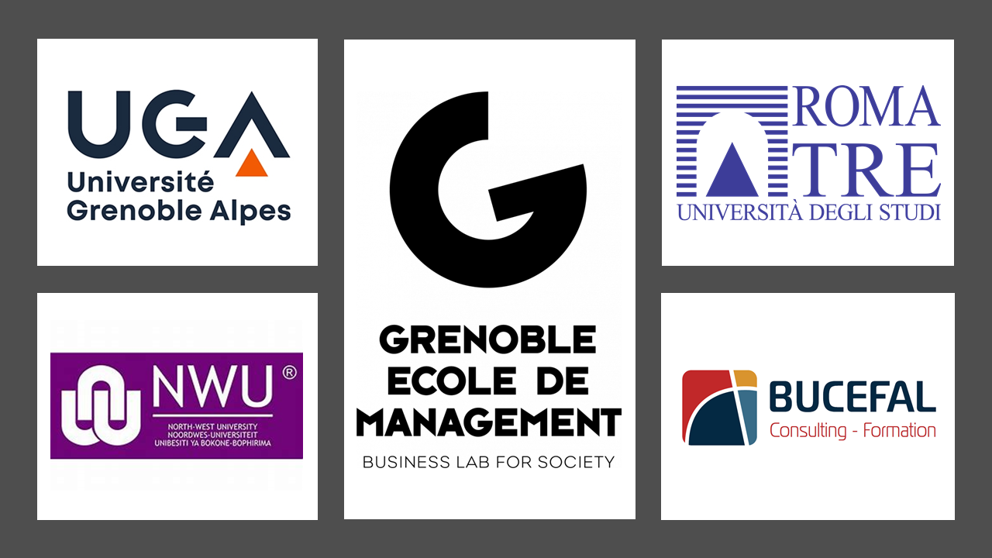
Supply chain resilience: Evidence from the Covid-19 crisis
Véronique Blum, Pierre Anger
Marco Venuti, Pieter Buys

Slide 2
overview OF the study
Objectives:
Can Covid crisis highlight abilities to resist to turbulences ?
Perimeter
international study with respondents in Italy, France, South Africa (66 resps)
A methodology path
What kind of Impact - Severity – Measures have the respondents experienced and developed
A mix between quantitative and qualitative data with open and closed questions

Slide 3
Demographics

Slide 4
Short term a demand generation and cash crisis
60% > Important or major revenue hit
46% > major impact on available cash

Slide 5
Key learnings on operations management
Impacts are rather concentrated on sales and customer related challenges with up to 66% experienced reduced or cancelled customer orders
50% experiencing more than 25% revenue hit over the period
No major impact on availability, price or quality of procured good or services excepted on covid related supplies
Main operations impact is coming from confinement measures (46%)
 | Nb. responses | %
Upstream or supplier related challenges | 32 | 23%
Production or ops mgt challenges | 39 | 28%
Sales and customers related challenges | 60 | 43%
Others | 10 | 7%

Slide 6
Investments are focused on the next wave horizon
In June 75% of the respondants are still in mitigation mode
As of today would you describe your company supply chain as being in one of the following stage ? | # | %
Avoiding the impacts of covid 19 crisis (evading any impact) | 7 | 9,38%
Mitigating the impacts of covid 19 crisis (minimizing the impacts between disruption and the start of recovery) | 1 | 50,00%
Stabilizing the impacts of covid 19 crisis (starting to recover from disruption) | 5 | 32,81%
Recovered from the impacts of covid 19 crisis (back to business as usual) | 2 | 15,63%
I don't know | 3 | 7,81%

Slide 7
Future thoughts
Systemic turbulence ? (Climate extreme events, geopolitical uncertainties, regulations uncertainties)
Demand predictability and increase turbulences are questioning the core business focus strategy
Value in profitability levels or in sustained profitability capabilities ?
Operating model resilience management framework ?
Time to survive / Time to recover
Resilience investments highlight ?

