Slide 1
ROI Broker Summit 2023
February 8, 2023

Slide 2
What’s the Secondary Patent Market?
Seller
Buyer
Licensee?

Slide 3
The ROI Patent Market Report
280K patent assets
16K offerings
$40B in buying opportunities
ROI Patent Market Report
2023 is our 11th annual report
First report had 186 packages covering 7,500 patent assets
“ROI’s brokered patent market report continues to be one of the year’s most read and anticipated pieces amongst IAM’s subscriber base of global IP executives and professionals”
- Joff Wild, Editor in Chief of IAM

Slide 4
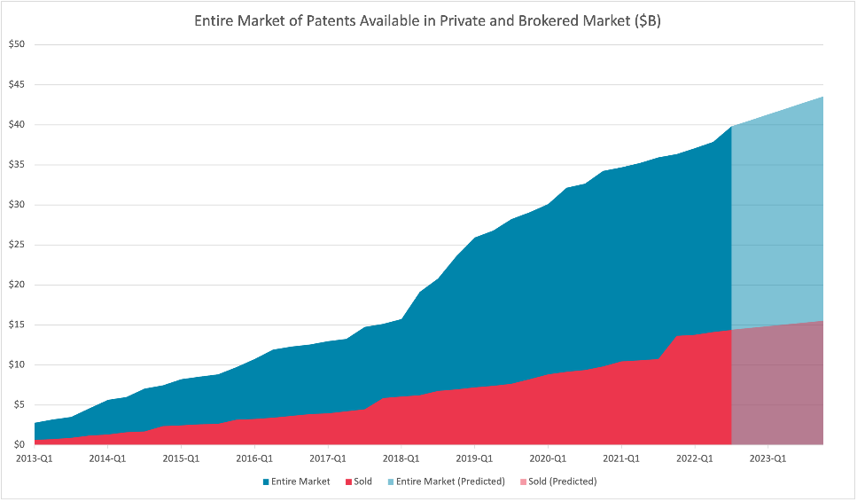
$40B in Patents on the Secondary Market
$B
Notes:
Private and public deals tracked by the ROL Group
Graph shows the cumulative asking price of sold and unsold assets. Where no asking price is provided by the seller, the average asking price is used.

Slide 5
Package Distribution by Technology
More packages in all categories for 2022
Big uptick in Hardware packages

Slide 6
EOU Rates are Low but Packages Sell Better
(Brokers Summit Attendees Can Use this Slide)
2.5X
Sales rate with an EOU versus not

Slide 7
Brokers Dominate the Market for Good Reasons
(Brokers Summit Attendees Can Use this Slide)
Brokers close deals 2.6x more than “For sale by owner”
Brokers dominate the market
ROI data from 2009-2022

Slide 8
What Percentage of Sales are Brokered?
(Brokers Summit Attendees Can Use this Slide)
90% of sales are brokered

