Slide 1
LES France General Assembly 2020 The Renaissance of IP & Innovation 8 December 2020
Audrey Yap,
Singapore
PRESIDENT
LES International

Slide 2
Renaissance
The period in European history making the transition from the middle ages to modernity.

Slide 3
The letters L, E, S and I are embedded in the tagline to show capacity to innovate is within us in LESI.
The logo is inspired by Galileo and the Renaissance, calling for a change in our paradigm as we pivot to High Growth Enterprises, SMEs, Start ups, using IP for business growth and work collaboratively around the world!
The vertical lines on the right denote growth and fiery colours, our passion for LES.

Slide 4
Innovate: defined as making changes to something established; especially by introducing new methods, ideas, product.
Innovation is about mindset, not just results.

Slide 5
Innovation need not be limited to new goods or methods of production but opening of new markets, conquests of new supplies or sources, executing new organisations, innovating new business models for markets or society, practical implementation for a more meaningful impact.
In management science & economics, innovation is bringing novel ideas together for effect in society – it is both process and outcome.

Slide 6
Innovation involves:
Combination of problem / opportunity identification.
Introduction / adoption / modification of new ideas germane to organization’s needs.
Promotion of idea.
Implementation of idea.
Source: Hughes, D; Lee, AJR; Tian, A; et al
Leadership, creativity and innovation
(2018) The Leadership Quarterly
pp 549 - 569

Slide 7
Concept of innovation is even older than the renaissance
“Kainotomia” (innovation) discussed by Greek philosopher Xenophon (430 – 355 BC).
Only after World War II did concept of innovation become popular.
Technological innovation tied to idea of economic growth and competitive advantage.
Source: Godin Benoit, 2019
“The Invention of Technological Innovation”
Edward Elgar Publishing UK

Slide 8
Recent times
Innovation explosion:-
Silicon Valley startups infotech boom, 1957 – 1980s.
Business incubators globally.

Slide 9
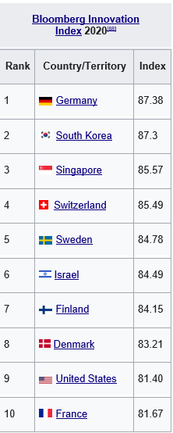
Innovation is hard to measure

Slide 10
Process of innovation
3 main phases
Ideation.
Problem solving.
Implementation.

Slide 11
Covid 19
The biggest economic shock since the Great Depression.
What will the push to innovate bring?

Slide 12
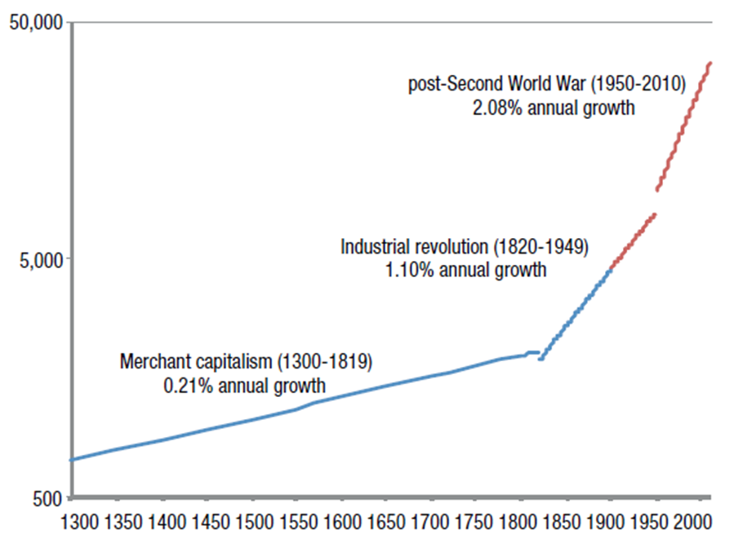

Slide 13
It is important in these times to not be defined by what limits us (pandemic; social distancing; no travel; economic constraints) but to energise ourselves to the creative process to innovate; to be the naïve expert again and ask “What if?”

Slide 14
At LESI in 2020/2021
We asked how can collaborations be reshaped?
A EPO-LESI workplan that was online focused for training, course materials, events, 31 activities for 9 initiatives.

Slide 15
EPO – LESI workplan initiative include:
Greater collaboration on conferences & meeting.
HTBC – Europe
HTBC – Asia
Pivot Online – HTBF – HTB related content & case studies alternate quarterly between Europe (EPO led), Asia & North America (LESI led).

Slide 16
EPO – LESI workplan (cont’d)
Training support & jointly developed masterclasses – LESI Pan-European Conference 2021 & several national society initiatives.
Participation at LESI leadership meetings – IMDM, Winter Planning (currently proposed online).
Continue with jointly developed / co-authored publications.

Slide 17
At LESI in 2020/2021
We asked how can collaborations be reshaped?
A financial course online with Moolman institute.
Currently looking to support national society collaborations with local IPOS.
Already working with WIPO on renewals of the 2010 MOU.

Slide 18
At LESI in 2020/2021
We asked how do we rebuild new community?
Over 50 webinars to date, 4 NPC, 2 committee leadership meetings, 6 virtual annual meeting (Turkey, Japan, USC, Asia Pac, Americas, France), 1 virtual tournament, several social activities (happy hour & networking).

Slide 19
At LESI in 2021
We asked if we did not need to travel, what could we do in a day?

Slide 21
Joyful Christmas
and Happy New Year!

Slide 22
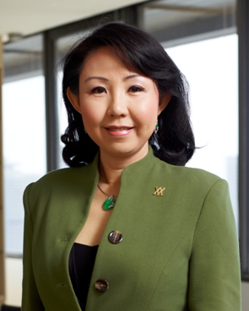
About the speaker
Audrey Yap Su Ming, President, LES International
Qualifications:
LL.B (Hons.) LL.M
Registered Patent Agent
Advocate & Solicitor Supreme Court of Singapore
Advocate & Solicitor High Court of Malaya
Solicitor of England & Wales
Commissioner For Oaths
Notary Public
WIPO Regional Consultant 2004-2006
Leading Lawyer, Who’s Who Legal Singapore 2008
IAM 250 Worlds Leading IP Strategists 2009, 2010, 2011
IAM 300 Worlds Leading IP Strategists 2012, 2013, 2014, 2015, 2016, 2017, 2018, 2019, 2020
Audrey is a Member of the Board of Directors of IP Office of Singapore since 2015 to date. She has served as a Board member of Enterprise Singapore from 2018 - 2020.
President, LES International; President, LES Singapore 2011-2013; Chair Asia-Pac Committee LES International.
Audrey’s career in law spans over 3 decades. She is well known amongst her clients & peers as an astute IP lawyer and strategist. In 1999 Audrey co-founded a boutique IP & corporate law firm Yusarn Audrey, offering legal and intellectual capital management as part of an integrated suite of IP solutions.
In 2012, Audrey served on IPOS Steering Committee on a National IP Competency Framework as well as on the IP sub Committee on “Developing a vibrant market place for IP transactions and commercialisation” for the purpose of the IP Hub Master Plan for Singapore, launched in March 2013.
Audrey is an Adjunct Fellow of the Intellectual Property Academy of Singapore. The World Intellectual Property Organisation (WIPO) appointed Audrey as Regional Consultant (IP) in 2004 to design and head up a study involving IP as an economic tool for ASEAN. Audrey served as an external expert for the European Patent Office (EPO) under the EC-ASEAN IP Cooperation Programme. She is cited in the Who’s who Legal 2008 as one the top lawyers in Singapore. Audrey served as an examiner for IPOS for the Patents Agents qualifying exams for several years.
Audrey serves as an Independent Director of an SGX listed company.
Audrey was Director of IPOS International and previously Advisor to IP ValueLabs at its inception.

Slide 23
Audrey Yap
audrey.yap@lesi.org
audrey@yusarn.com

