Slide 1

HOW COVID & DIGITAL ACCELERATION HAS RESHAPED COMPLIANCE
The Transformation of Software Audits

Slide 2

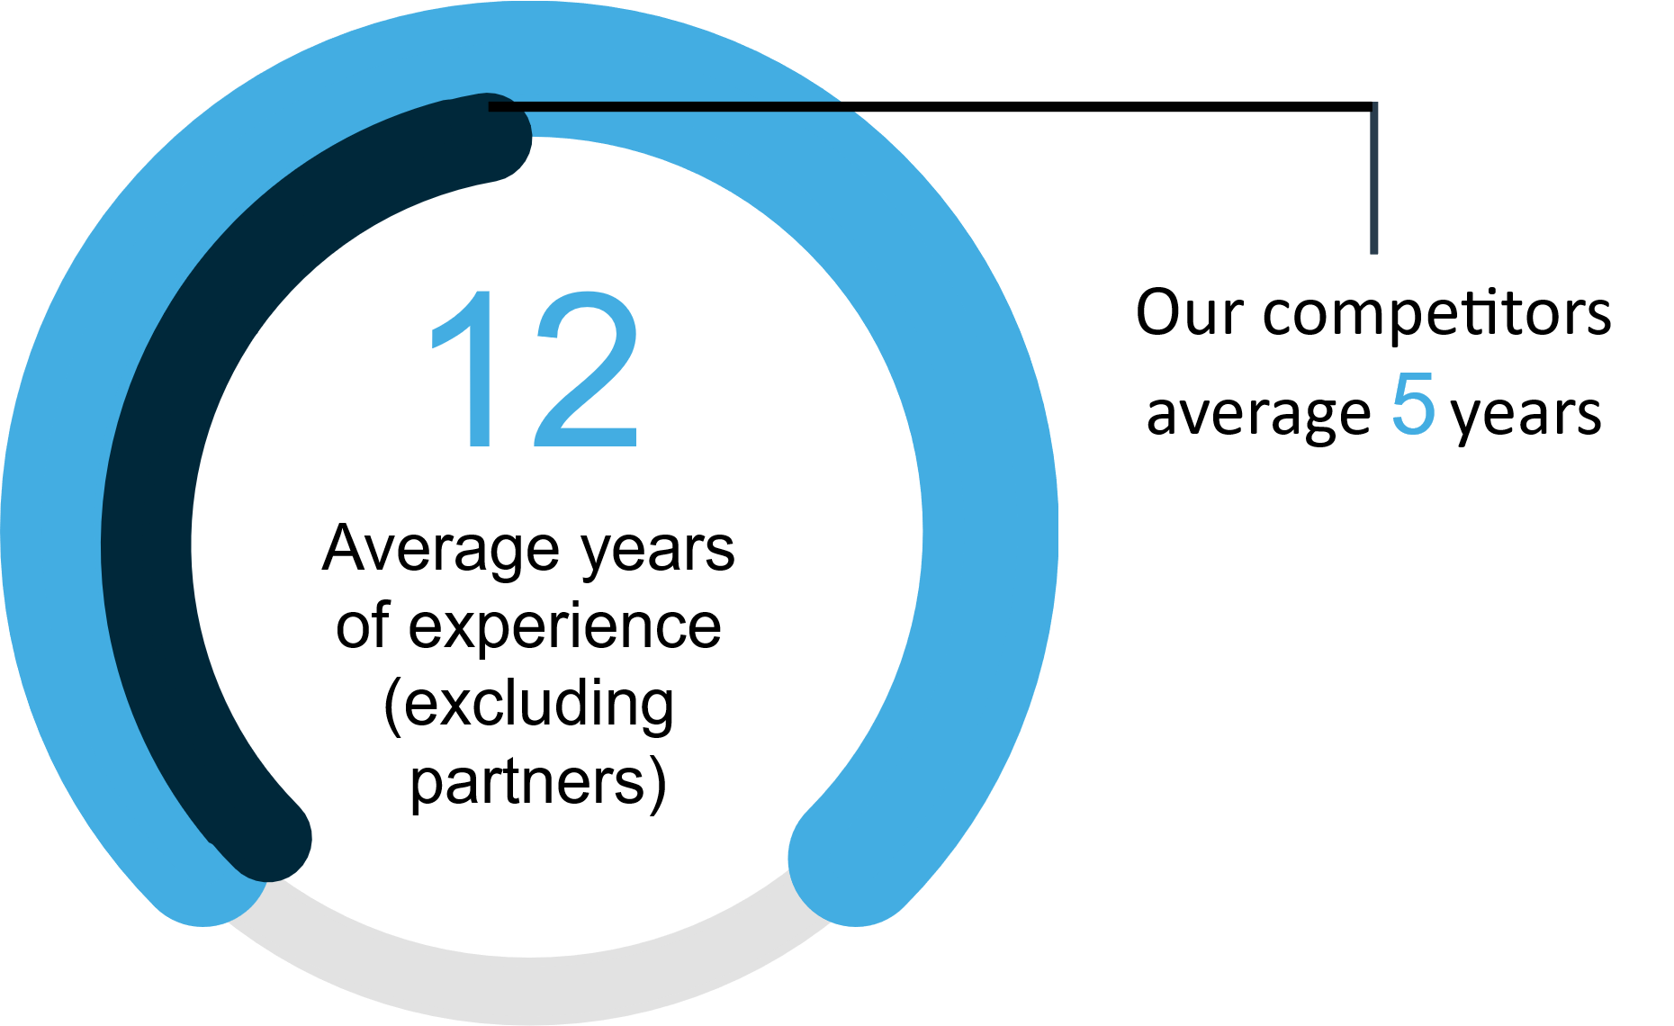


A GLOBAL CUSTOMER SERVICE MODEL BUILT AROUND YOU
140
6K+
82%
Resources with compliance expertise
Growth in 2020 – Driven by Digital Adoption
Completed Engagements
Compliance
Auditors
18
15
1
Software
Advisory
Industry
Experts
Languages
Countries where our
resources are based
Coming Soon

Slide 3











PARTNER TO THE WORLDS LEADING BRANDS

Slide 4


TRADITIONAL SOFTWARE COMPLIANCE – PRE COVID
Primary Audit Strategy
Anti Piracy Compliance
Full Scope Audits
  Onsite
  Remote
Other Engagements by Limited Number of Companies
  Self Certification
  True Up
Enterprise Engagements Driven by Internal Resources
Extensive Legal Firm Support Globally
Letter Campaigns
Engagement Models
Engagement Models
Enterprise Engagements Driven by Internal and 3rd party Resources
Extensive Legal Firm Support Globally
Letter Campaigns
Email
Feet On the Street
In Person

Slide 5
PRE-COVID CHALLENGES
Scalability
Both Software Audits and Anti-Piracy were heavily dependent on resources (Internal or External)
Balancing Revenue & Roi Goals
Growing the Top Line while maintaining or improving ROI without Tools and Technology
Global Needs
Building Teams, Infrastructure and 3rd Party Relationships globally while growing revenue
Transforming with their Organizations
Companies were rapidly transforming their business models, customer success programs and customer engagement strategies.

Slide 6
COVID-19 HAS ACCELERATED THE NEED FOR CHANGE
Common Learnings Across The Business World
License Compliance is not exempt from Covid-19
1
1
Companies are taking greater responsibility for, and interest in the health and safety of employees
Feet on the street programs will dry up – Employee safety
Digitalization has been accelerated
2
Raids will be harder to initiate for the short-medium term – Employee safety
2
3
3
Organizations need to be flexible and open to new ways of working
Remote working will impact intelligence and action:
WFH is accelerating piracy – also making it difficult to detect and assign to company
Investigations will be more challenging
Less investigators due to pandemic and safety concerns amongst investigators
Infringement fidelity
Adapt, pivot and reshape your business mindset is encouraged
4
5
Companies are adopting new modes of communication
Budgets will be tighter across both infringers and existing customers
4
Teams and organizations are finding new ways to collaborate
6
5
LC team structures for customer engagement and resolution may be impacted – local teams,
travel restrictions
7
Teams are managing unpredictable volumes and new workflows
Possible impact on cycle times for new cases – engagement and resolution
6
Improving Productivity and Innovating faster is a must
8
7
Traditionally LC teams have relied on F2F discussions and resolutions – remote negotiation
style/skills
Reskilling the workforce will be constant – tied to digitalization & negotiation
9

Slide 7
LEADING COMPLIANCE TEAMS ARE TRANSFORMING
Digitize Engagements
Be Data
Centric
Expand Engagement Strategies
Focus on Customer Experience, Scale, and Localization
Expand Beyond Targeting Non Compliance
Align Engagement to Buyers Journey
Data Driven Decisions – including re-engagement
Adopt New Engagement Strategies aligned to organization goals
Integrate the Eco-system
Technology and Tools Driving Change – not More Resources

Slide 8







TRANSFORMATIVE ENGAGEMENT STRATEGIES
ALIGNED TO THE CUSTOMER JOURNEY
License Compliance
SAM and Advisory Solutions
Conversion
Monitor
Education
Partner
Enablement
Engagement
Identify
Retention
Consideration
Awareness
Services
Customer Success
Renewals

Slide 9
OUR TECHNOLOGY ACCELERATION SINCE COVID
ConnorX
Digitizing the customer engagement
Localized on brand experience
Multi-channel engagement
Optimized outreach by compliance or
SDR engagement teams
Unparallel insights and scoring
Flexible & agile for optimizing conversions
Enhanced targeting & scoring solutions
Customized automated data processing :
SAM & Monitoring tool outputs
Discovery Scripts
Screenshots
Actionable Business Intelligence
Net licensing positions
Customized visualized customer footprints and infrastructure summaries
Data Platform

Slide 10
DIGITIZING CUSTOMER EXPERIENCE
EMPOWERING DIGITAL HUMANISM
Emails
(HTML supported)
Inbound Call
Monitoring
Data Collection Portal
Landing Pages
with Live Chat
Physical Mail
Webinar
SMS (Texts)
Integrated
Call Center

Slide 11
EXTENDING MUTUAL INVESTMENTS FOR COLLECTIVE SUCCESS
CASE STUDIES
Non Genuine Use
Digitizing, Localizing Scaling Customer Engagement
- New Partnerships with CJCH and Rouse
ConnorX Engagement
Customer True-Up
Expanding Compliance engagements aligned to renewals and customer success
ConnorX Engagement
License Advisory
Trust and Transparency Program – Partner Enablement
Audit + Advisory
Remote Audit
Localized Remote Audits in Japan & SEA for Mid-Market & SMB Customers
Audit + ConnorX

